Slide 1
Computation of matrix functions with fully automatic Schur-Parlett and Rational Krylov methods.
Roberto Zanotto | PD2GGALN 2018

Slide 2
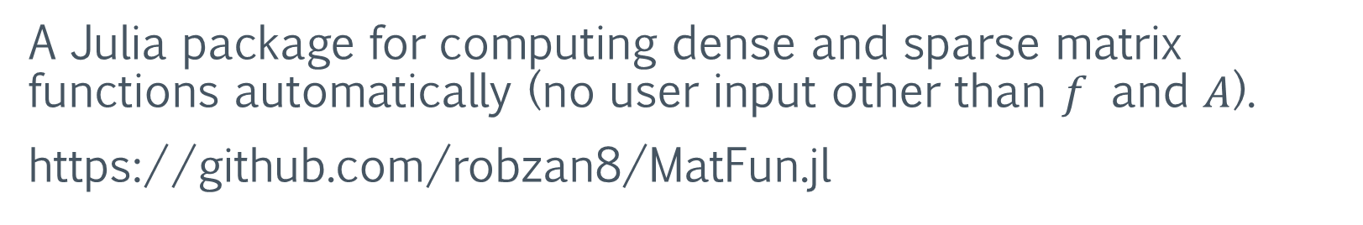
About me
Computer Science student at the University of Pisa.
Master’s degree thesis under supervision of Federico Poloni.
MatFun
A Julia package for computing dense and sparse matrix functions automatically (no user input other than $f$ and $A$).
https://github.com/robzan8/MatFun.jl

Slide 3
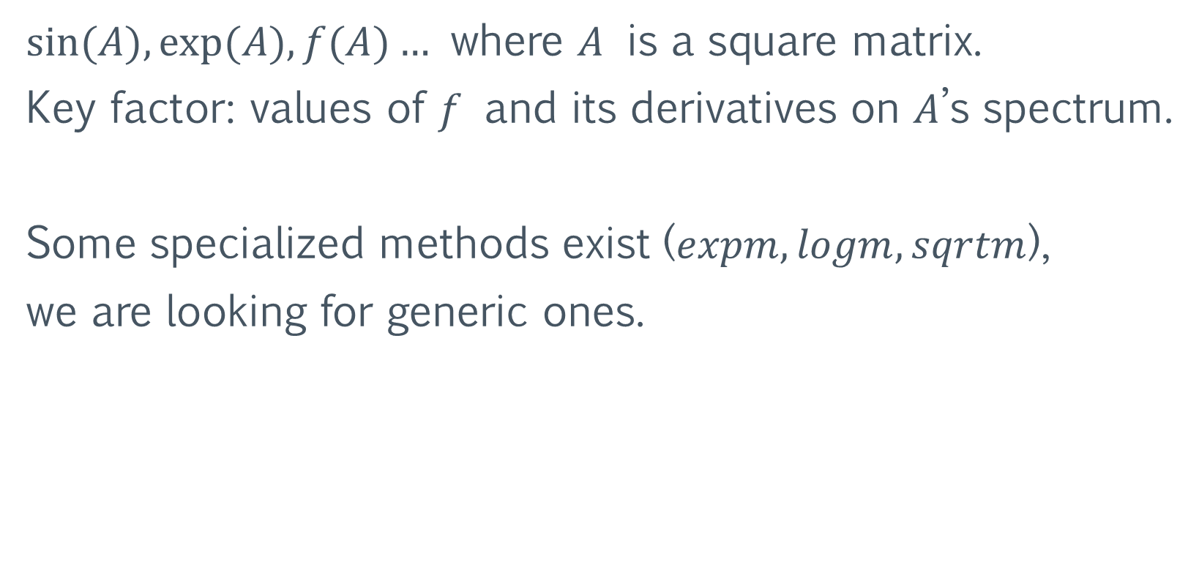
Matrix Functions
$sin⁡(A), exp⁡(A), f(A)…$ where $A$ is a square matrix.
Key factor: values of $f$ and its derivatives on $A$’s spectrum.
Some specialized methods exist ($expm, logm, sqrtm$),
we are looking for generic ones.

Slide 4
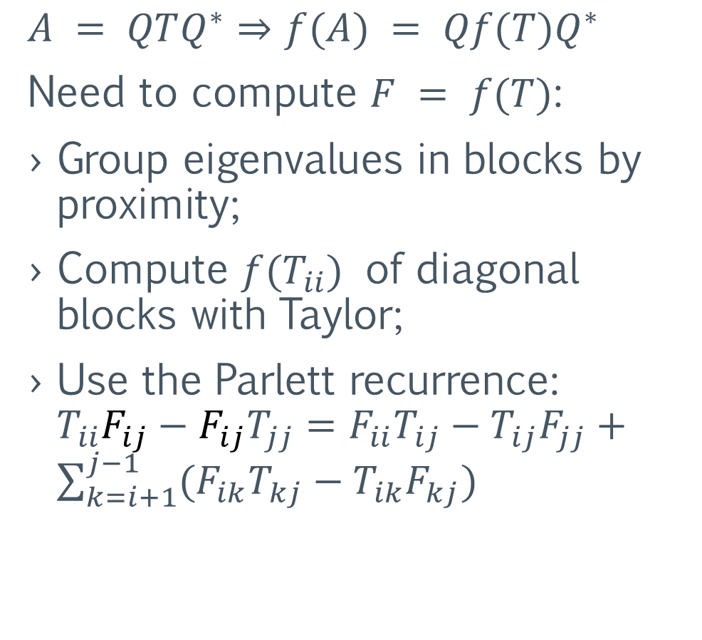

Schur-Parlett – dense matrix functions
Proposed by $\text{Higham} \text{and} \text{Davies} \text{in}\text{ 2003.}$
$$A = QTQ^{∗}⇒f(A) = Qf(T)Q^{∗}$$
Need to compute $F = f(T)$:
Group eigenvalues in blocks by proximity;
Compute $f(T_{ii})$ of diagonal blocks with Taylor;
Use the Parlett recurrence: $T_{ii}F_{ij}−F_{ij}T_{jj}=F_{ii}T_{ij}−T_{ij}F_{jj}+\sum_{k=i+1}^{j−1}{(F_{ik}T_{kj}−T_{ik}F_{kj})}$

Slide 5
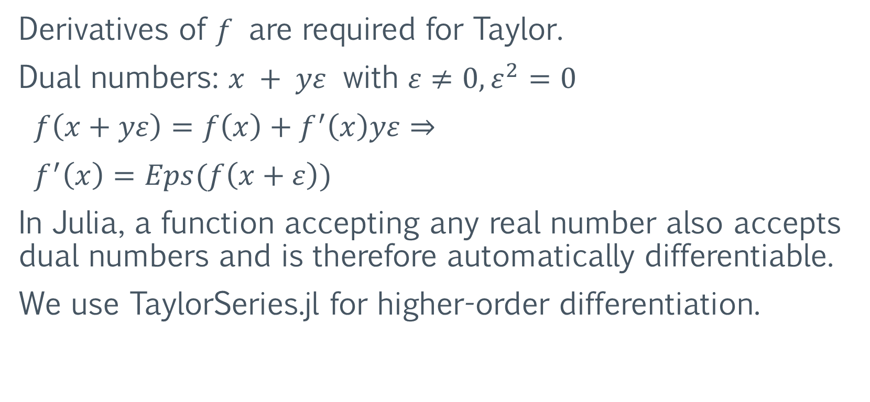
Schur-Parlett – automatic differentiation
Derivatives of $f$ are required for Taylor.
Dual numbers: $x + yε$ with $ε≠0, ε^{2}=0$
$f\left(x+yε\right)=f\left(x\right)+f^{′}\left(x\right)yε⇒$
$f^{′}\left(x\right)=Eps(f\left(x+ε\right))$
In Julia, a function accepting any real number also accepts dual numbers and is therefore automatically differentiable.
We use TaylorSeries.jl for higher-order differentiation.

Slide 6
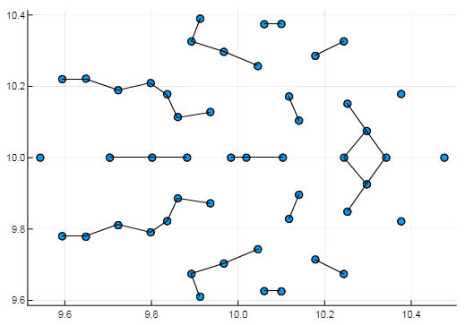

Schur-Parlett – numerical accuracy
Boils down to how well the eigenvalues can be clustered:
Relative error versus MatLab’s Symbolic Toolbox (on 50x50 random matrix):
 | Specialized method | Schur-Parlett
exp | 1.0e-14 | 1.5e-13
log | 4.0e-14 | 4.1e-14
sqrt | 4.3e-14 | 4.5e-14
$$⇒$$
Can behave badly (7e-4) with “snake” eigenvalues (as shown in original paper, experiment 4)

Slide 7

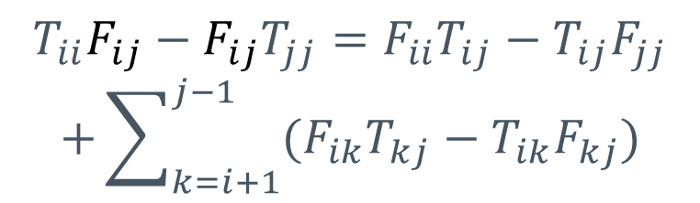
Schur-Parlett – performance improvements
Parlett recurrence made recursive and cache-oblivious.
$$⇒$$
$$T_{ii}F_{ij}−F_{ij}T_{jj}=F_{ii}T_{ij}−T_{ij}F_{jj}$$
$$+\sum_{k=i+1}^{j−1}{(F_{ik}T_{kj}−T_{ik}F_{kj})}$$
$$T_{11}F_{12}−F_{12}T_{22}=F_{11}T_{12}−T_{12}F_{22}$$
~3x speedup for n = 2500

Slide 8


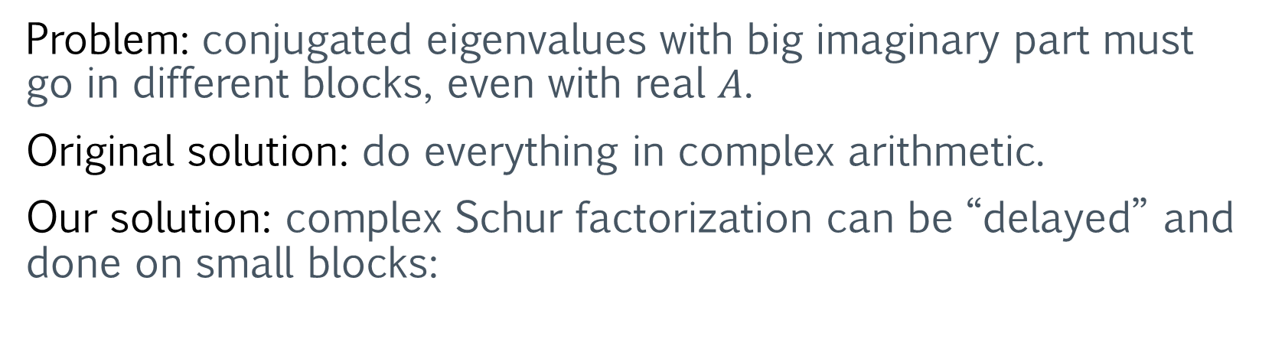
Problem: conjugated eigenvalues with big imaginary part must go in different blocks, even with real $A$.
Original solution: do everything in complex arithmetic.
Our solution: complex Schur factorization can be “delayed” and done on small blocks:
small
complex
Schur
real
Schur
$$⇒$$
$$⇒$$
Also allows for Parlett recurrence with real Sylvester equations, ~2x speedup for n = 2500 on whole Schur-Parlett.

Slide 9

Schur-Parlett – performance results
The whole procedure typically spends ~2/3 of the time doing $A$’s Schur decomposition (varies depending on the eigenvalues’ distribution).

Slide 10
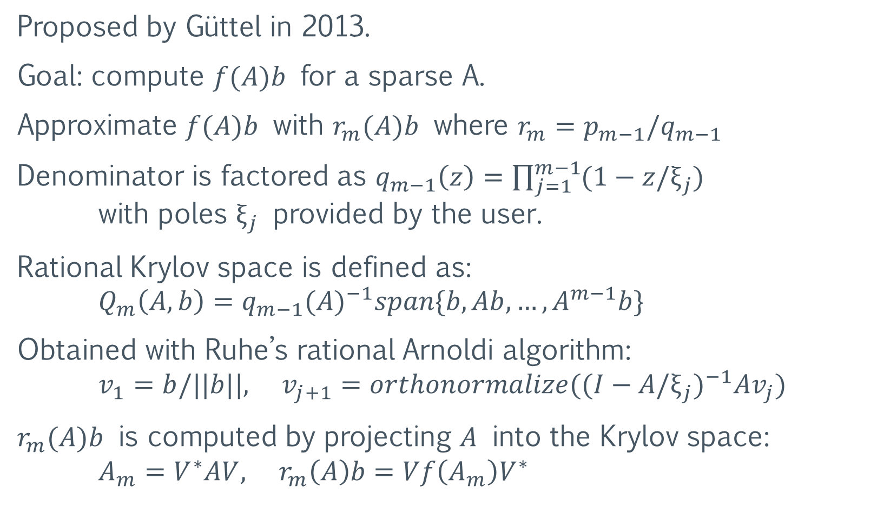
Rational Krylov – sparse matrix functions
Proposed by Güttel in 2013.
Goal: compute $f(A)b$ for a sparse A.
Approximate $f(A)b$ with $r_{m}(A)b$ where $r_{m}=p_{m−1}/q_{m−1}$
Denominator is factored as $q_{m−1}\left(z\right)=\prod_{j=1}^{m−1}{(1−z/ξ_{j})}$ with poles $ξ_{j}$ provided by the user.
Rational Krylov space is defined as: $Q_{m}\left(A, b\right)=q_{m−1}{(A)}^{−1}span\{b, Ab,…,A^{m−1}b\}$
Obtained with Ruhe’s rational Arnoldi algorithm: $v_{1}=b/||b||, v_{j+1}=orthonormalize({(I−A/ξ_{j})}^{−1}Av_{j})$
$r_{m}(A)b$ is computed by projecting $A$ into the Krylov space: $A_{m}=V^{∗}AV, r_{m}\left(A\right)b=Vf\left(A_{m}\right)V^{∗}$

Slide 11
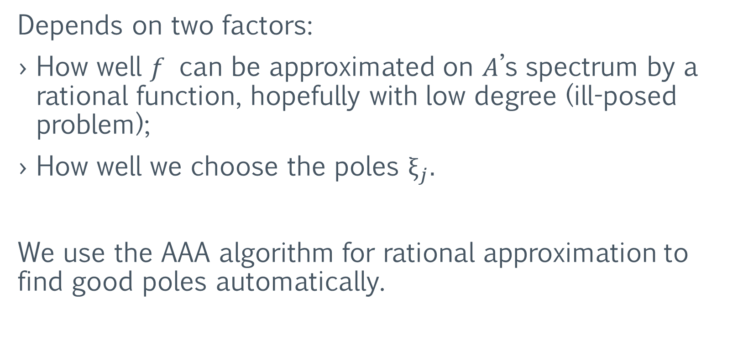
Rational Krylov – approximation accuracy
Depends on two factors:
How well $f$ can be approximated on $A$’s spectrum by a rational function, hopefully with low degree (ill-posed problem);
How well we choose the poles $ξ_{j}.$
We use the AAA algorithm for rational approximation to find good poles automatically.

Slide 12
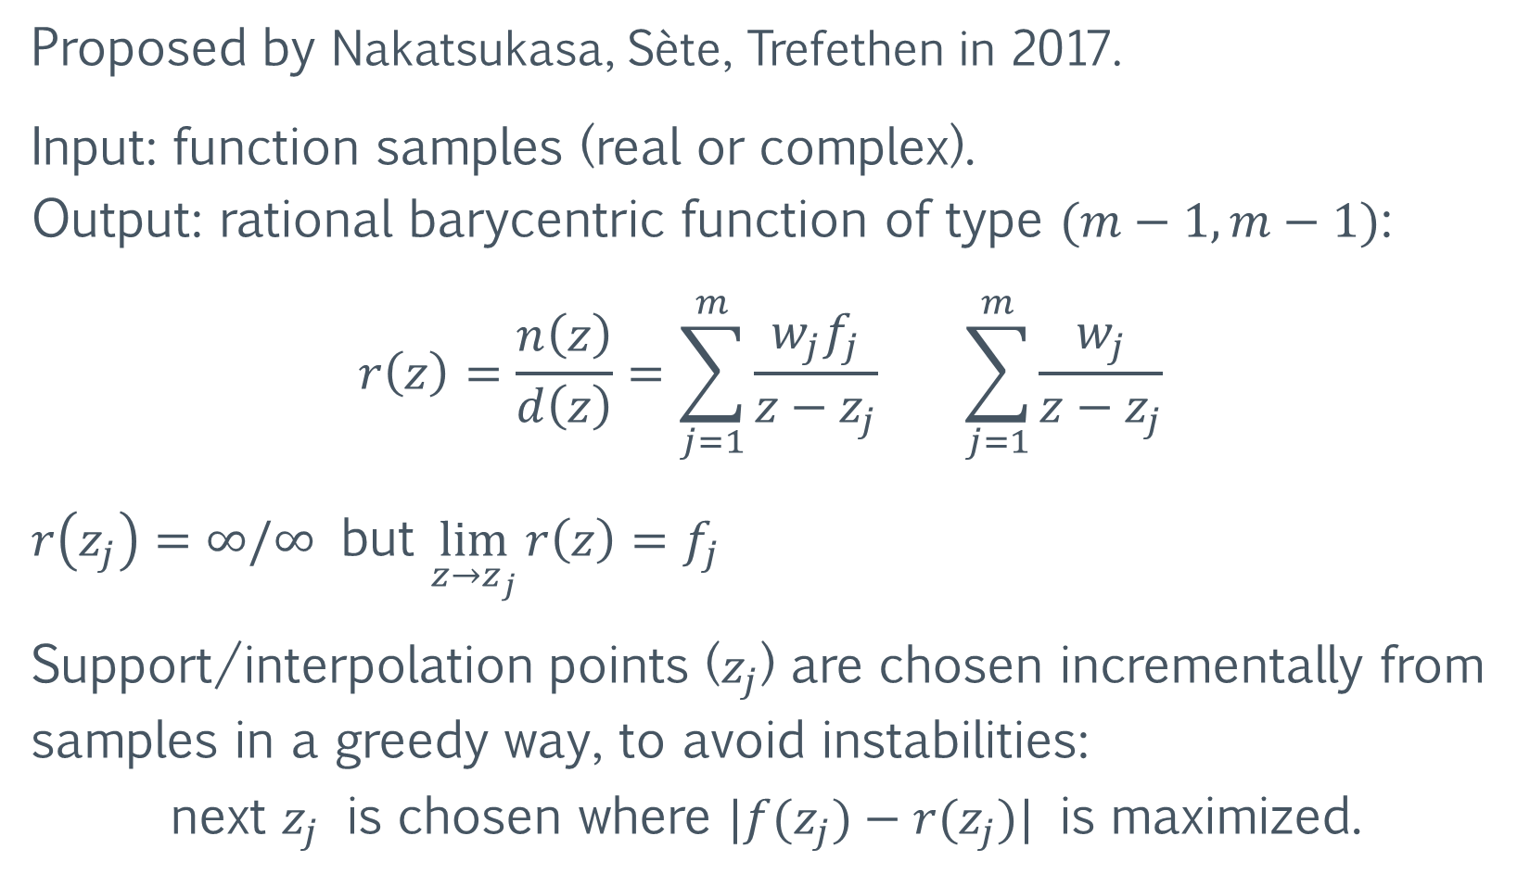
AAA algorithm for rational approximation
Proposed by Nakatsukasa, Sète, Trefethen in 2017.
Input: function samples (real or complex). Output: rational barycentric function of type $(m−1, m−1)$:
$$r\left(z\right)=\frac{n\left(z\right)}{d\left(z\right)}=\sum_{j=1}^{m}{\frac{w_{j}f_{j}}{z−z_{j}}} \sum_{j=1}^{m}{\frac{w_{j}}{z−z_{j}}}$$
$r\left(z_{j}\right)=∞/∞$ but $\lim_{z→z_{j}}{r\left(z\right)}=f_{j}$
Support/interpolation points ($z_{j}$) are chosen incrementally from samples in a greedy way, to avoid instabilities: next $z_{j}$ is chosen where $|f(z_{j})−r(z_{j})|$ is maximized.

Slide 13
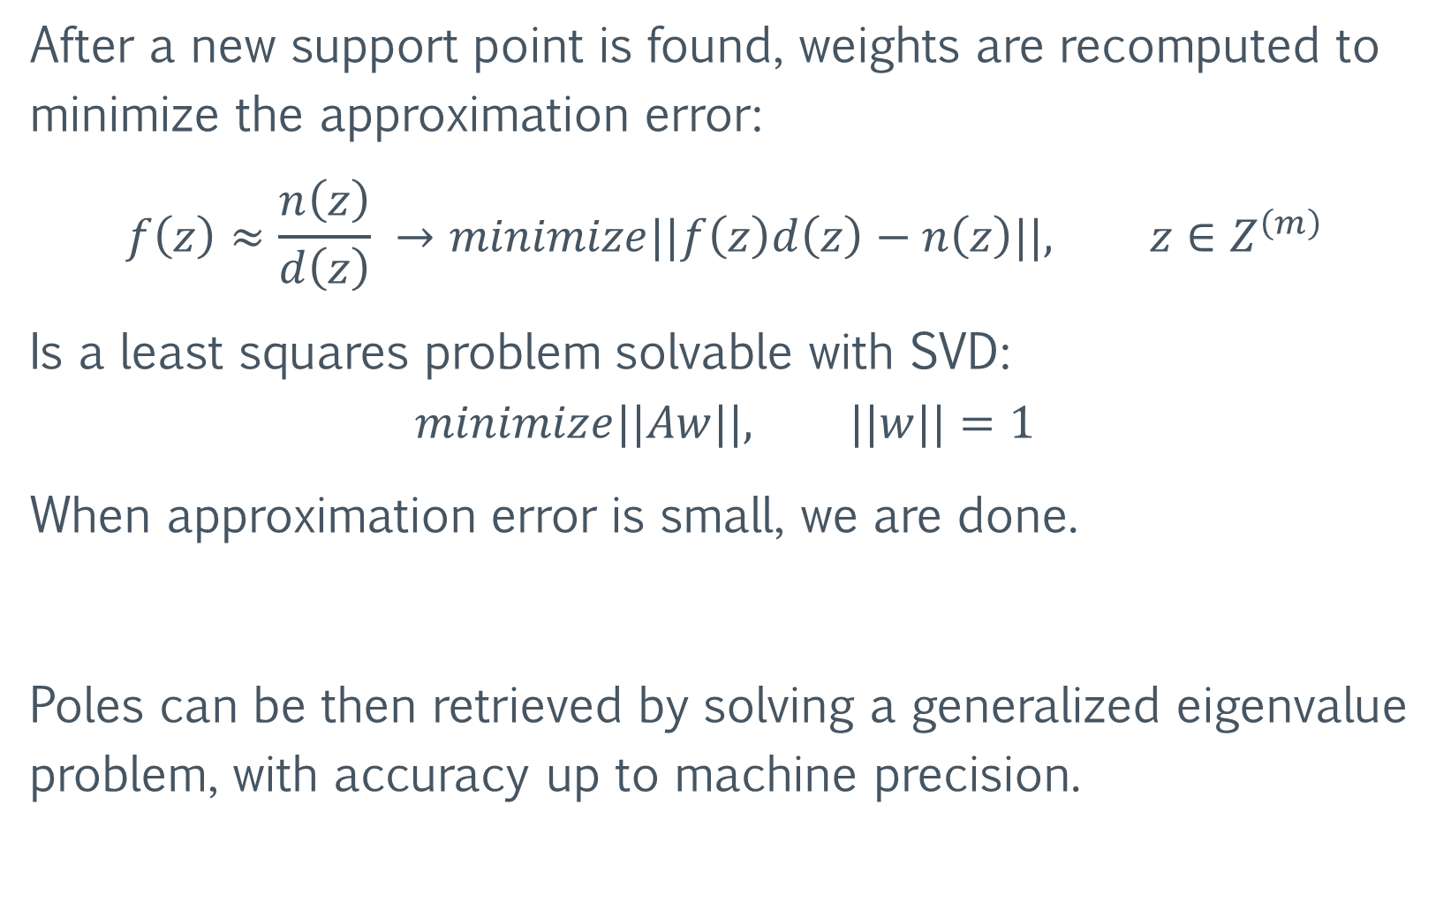
After a new support point is found, weights are recomputed to minimize the approximation error:
$$f\left(z\right)≈\frac{n\left(z\right)}{d\left(z\right)} →minimize||f\left(z\right)d\left(z\right)−n\left(z\right)||, z∈Z^{\left(m\right)}$$
Is a least squares problem solvable with SVD:
$$minimize||Aw||, ||w||=1$$
When approximation error is small, we are done.
Poles can be then retrieved by solving a generalized eigenvalue problem, with accuracy up to machine precision.

Slide 14
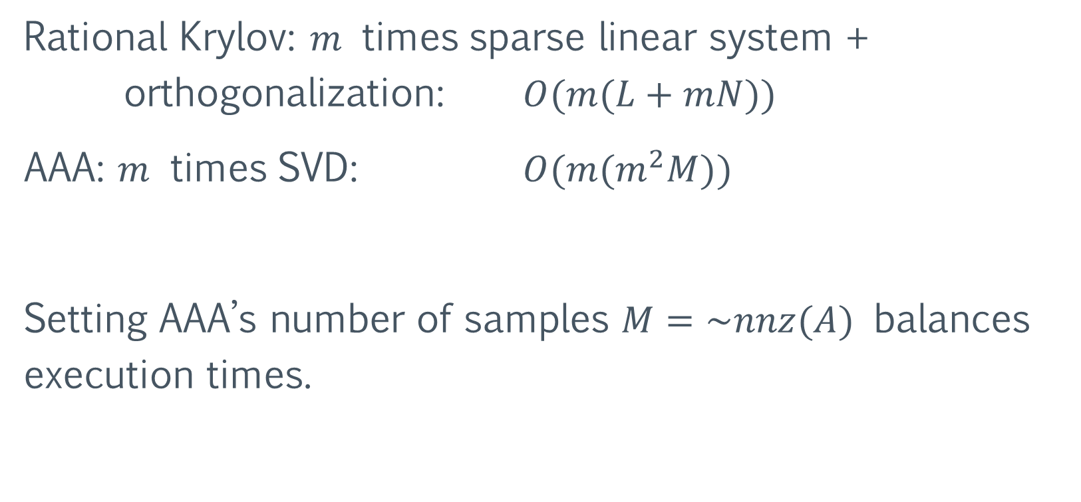
Performance of Rational Krylov + AAA
Rational Krylov: $m$ times sparse linear system + orthogonalization: $O(m(L+mN))$
AAA: $m$ times SVD: $O(m(m^{2}M))$
Setting AAA’s number of samples $M=\sim nnz(A)$ balances execution times.

Slide 15


Accuracy of Rational Krylov + AAA
Matrices are from the SuiteSparse Matrix Collection. $exp⁡(A)b$ with Krylov is compared with dense $expm$:
Problem type | name | size(A) | cond(A) | # poles | accuracy | # poles | accuracy
2D/3D problem | jagmesh | 1089 | 1168 | 9 | 1.5e-6 | 15 | 6.0e-14
Fluid dynamics | sherman4 | 1104 | 2178 | 11 | 6.6e-6 | 19 | 6.7e-10
Structural problem | can_1072 | 1072 | 2.0e34 | 11 | 7.3e-6 | 23 | 1.7e-14
Directed graph | SmaGri | 1059 | Inf | 9 | 2.6e-7 | 21 | 7.3e-13
I haven’t implemented the estimator of $cond(f(A))$ yet ☹

Slide 16
Try it out at:
https://github.com/robzan8/MatFun.jl
Questions?

